Slide 1


Data Structures and Algorithm II
Decision Tree
Addin Aditya, S.Kom., M.Kom.
addin@stiki.ac.id

Slide 2
Introduction
Tree represents the nodes connected by edges. Not like array, tree is a nonlinear structure data with special behavior.
Binary Tree is a special data structure used for data storage purposes. A binary tree has a special condition that each node can have a maximum of two children. A binary tree has the benefits of both an ordered array and a linked list as search is as quick as in a sorted array and insertion or deletion operation are as fast as in linked list.
For examples: family hierarchy, tournaments, organization structural

Slide 3
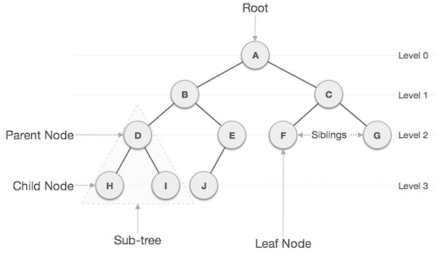

Slide 4
Binary Search Tree
NODE
LEAF

Slide 5
Binary Search Tree
LEFT SUBTREE

Slide 6
Binary Search Tree
RIGHT SUBTREE

Slide 7
Important Terms
Path − Path refers to the sequence of nodes along the edges of a tree.
Root − The node at the top of the tree is called root. There is only one root per tree and one path from the root node to any node.
Parent − Any node except the root node has one edge upward to a node called parent.
Child − The node below a given node connected by its edge downward is called its child node.
Leaf − The node which does not have any child node is called the leaf node.
Subtree − Subtree represents the descendants of a node.
Visiting − Visiting refers to checking the value of a node when control is on the node.
Traversing − Traversing means passing through nodes in a specific order.
Levels − Level of a node represents the generation of a node. If the root node is at level 0, then its next child node is at level 1, its grandchild is at level 2, and so on.
keys − Key represents a value of a node based on which a search operation is to be carried out for a node

Slide 8
Tree Facts
Every nodes, except root has only one parent
Once a link from a parent to a child followed, there is no way to come back to its parent through another link
Subtree is a set of nodes

Slide 9
Binary Tree
Is a organized nodes that ordered hierarchical. Every node has no
Its implementation was done by linked-list. Every node has three parts, it is data / info and two pointers
Left pointer | Data / info | Right pointer

Slide 10
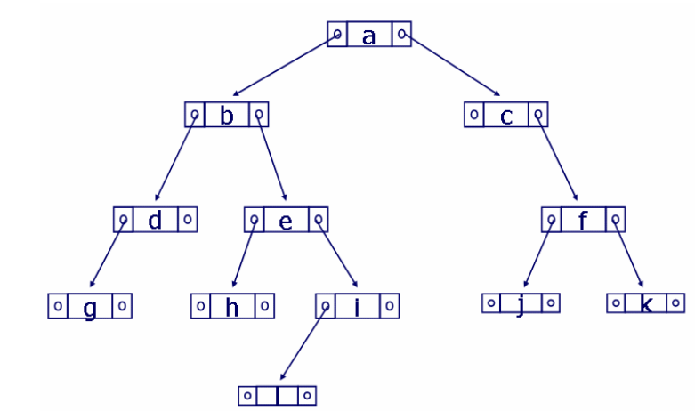
Binary Tree

Slide 11
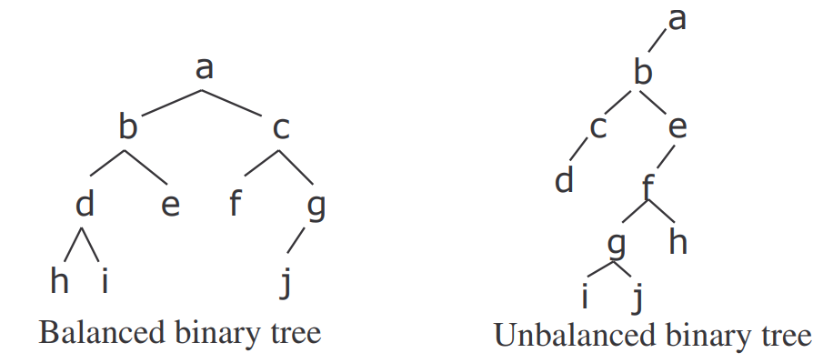
Balancing
A binary tree is going to be balance if every top level / parent is full
While unbalanced tree is happened when there is a not full parent

Slide 12
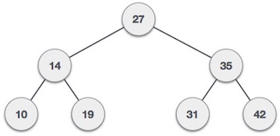
Binary Search Tree (BST) Representation
Binary Search tree exhibits a special behavior. A node's left child must have a value less than its parent's value and the node's right child must have a value greater than its parent value

Slide 13
Tree Node
struct node {
int data;
struct node *leftChild;
struct node *rightChild;
};

Slide 14
Tree Algorithm
Prepare a new node
Allocate the memory
Insert the data / info
Set right and left pointer = null;
Paste it on the right place
Searching → to determine the precise position; if the data / info is lower than its parent, it will accessed with left pointer and vice versa
Placing →

Slide 15
BST Basic Operations
The basic operations that can be performed on a binary search tree data structure, are the following −
Insert − Inserts an element in a tree/create a tree.
Search − Searches an element in a tree.
Preorder Traversal − Traverses a tree in a pre-order manner.
In-order Traversal − Traverses a tree in an in-order manner.
Post-order Traversal − Traverses a tree in a post-order manner

Slide 16
Traversal Method
From root, traverse every nodes just once
There are 3 ways: pre-order, in-order, post-order
It could been done in recursive way

Slide 17
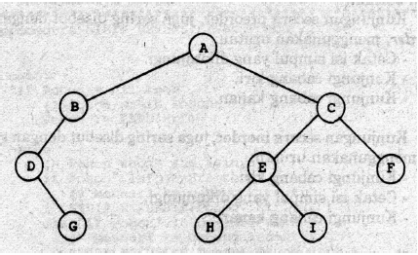
Pre-order Traversal (Depth First Order)
Print the info on traversed node
Go to left branch
Go to right branch

Slide 18
Pre-Order Algorithm (Recursive)

Slide 19
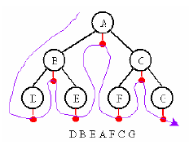
In-Order Traversal (Symmetric Order)
Go to left side
Print(); the traversed node
Go to right side

Slide 20
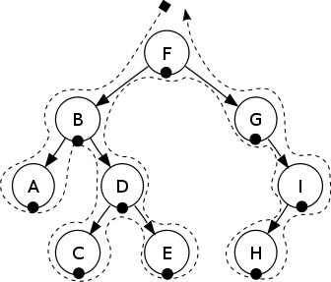
In-Order Traversal
A-B-C-D-E-F-G-H-I

Slide 21
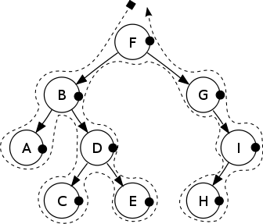
Post-Order Traversal
Go to left side
Go to right side
print(); the traversed node

Slide 22
Post-Order Traversal

Slide 23
Binary Search Tree
Rules
Left child < Root
Right child > Root
Less → put it on left-side
More → put it on right-side

Slide 24
Insert
Contoh :
Data : 60, 75, 25, 50, 66, 15, 33, 44
60
Root

Slide 25
Insert
Contoh :
Data : 60, 75, 25, 50, 66, 15, 33, 44
75
>
60

Slide 26
Insert
Contoh :
Data : 60, 75, 25, 50, 66, 15, 33, 44
25
<
60
75

Slide 27
Insert
Contoh :
Data : 60, 75, 25, 50, 66, 15, 33, 44
50
<
60
25
75

Slide 28
Insert
Contoh :
Data : 60, 75, 25, 50, 66, 15, 33, 44
60
50
25
75
>

Slide 29
Insert
Contoh :
Data : 60, 75, 25, 50, 66, 15, 33, 44
60
25
75
50

Slide 30
Insert
&
Seterusnya
☺
Contoh :
Data : 60, 75, 25, 50, 66, 15, 33, 44
60
25
75
50

Slide 31
Delete
Case 1 : Node without child
Delete immediately
Case 2 : Node with one child
Move the child into the deleted parent’s place
Case 3 : Node with two child
Replace the deleted parent with the left child.
Notes:
Untuk kasus 3:
Dalam bahasa yang lebih sederhana dapat dituliskan sbb:
Cara pertama : kanan satu, kmd menuju child terkiri
Cara kedua : kiri satu, kmd menuju child terkanan

